Slide 1

Understanding Advanced Regression Techniques
By analyzing Housing Price Dataset
Team Name: We R Ready
Team Members: Jiehao Pan, Santosh Mysore Vasudevan,
Siqi Wan, Yan Tan, Yanjun Yang

Slide 2

Objectives
Understanding advanced regression techniques like Random Forest and Gradient Boosting
Compare the model with Linear regression
Predict the sale price of residential houses in Ames, IA based on features describing various aspects of a house.

Slide 3
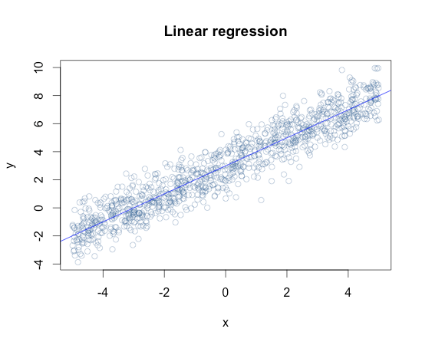
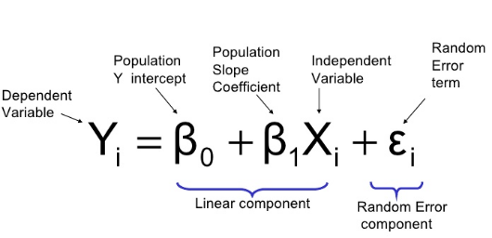
Introduction : Models
Linear Regression :

Slide 4
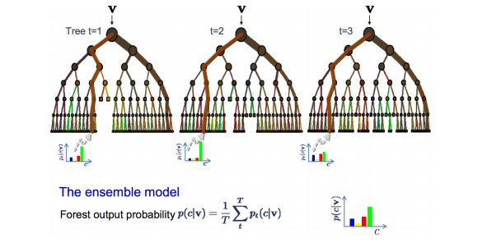
Introduction : Models
Random Forest:
Methodology:
Bootstrap Samples and at each split, bootstrap variables
Grow multiple trees and vote
Pros:
Accuracy
Cons:
Speed, Interpretability, Overfitting

Slide 5
Introduction : Models
Boosting:
Methodology:
Start with a set of classifiers h1,........hk (example: All possible trees, all possible cutoffs, etc.,)
Create a classifier that combines classification functions: f(x)=sgn(Σ at ht(x)) (for t=1 to T)
Iterative, select one h at each step
Calculate weights based on errors
Upweight missed classification and select next h
Boosting can be used with any subsets of classifiers. One large subclass is gradient boosting.

Slide 6
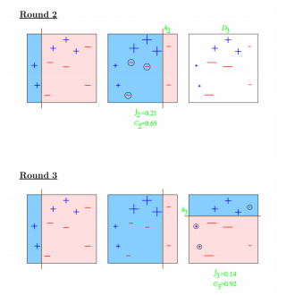
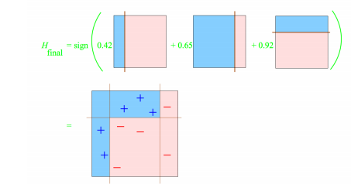
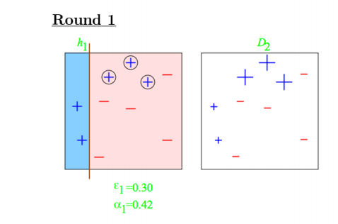
Introduction : Models
Boosting:

Slide 7
Data Description
Train dataset: 1460 rows, 81 variables
Test dataset: 1460 rows, 80 variables
Target variable: Sale price
Continuous data: lot frontage, lot area, overall quality, overall condition rating...
Categorical data: street type, alley type, lot shape, land contour, utilities...

Slide 8

Data Preparation
Missing Values
Data Splitting

Slide 9

Data Preparation
Missing Values
Recode categorical variables missing values into No category
“Garage Quality”----- NA= No Garage
Imputation based on logical rules
Select the level with the most records

Slide 10

Data Preparation
Missing Values
Deleting Near Zero Variance Variables
“nearZeroVar” --- find the variables with low variation
Input and Standardize Variable
“LotFrontage”--- (KNN) K Nearest Neighbor transform
“YearBuilt”--- 2016-YearBuilt

Slide 11

Data Preparation
Raw Data Splitting
60% Training
40% Testing

Slide 12
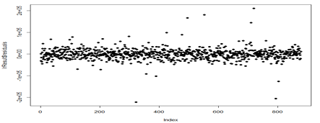
Linear Regression Model

Slide 13
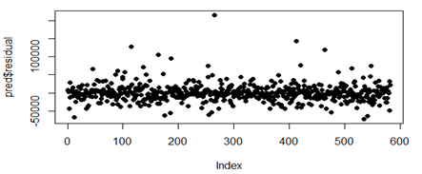
Random Forest Model

Slide 14
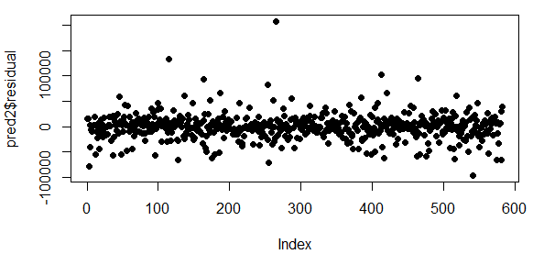
Gradient Boost Model

Slide 15
Model Comparison
The predicting with trees perform better than linear regression model

Slide 16
Random Forest VS Gradient Boost
Random Forest
Gradient Boost
Grow Trees in Parallel Grow Trees in Sequence
Much easier to tune Well-tuned GBM can outperform RF
Much harder to overfit More likely to overfit

Slide 17

R package Used
Caret
Functions:
Data Splitting- createDataPartition
Data Preprocess - preProcess
Modeling - train
Predicting - predict
A set of function that attempt to streamline the process for creating predicting models

Slide 18

Any Question?

